Slide 1
OT-ST-WS-08 | Data preparation
2. Climate model data (Nikolay Koldunov)

Slide 2
Housekeeping
We will have 2 sessions:
10:00-12:00
13:00-15:00
Code and presentations are located: https://github.com/koldunovn/DT_model_data

Slide 3
About me
Nikolay Koldunov
Scientist at Alfred Wegener Institute for Polar and Marine Research (awi.de)
Work with ocean and climate models, specialise on very high resolution modelling, Arctic Ocean and sea ice.
More than 15 years of experience working with climate model data, more than 13 years I am doing it with python.
Website: http://nikolay.koldunov.net/
Tweeter: @oceanographer

Slide 4
What this course is about
We are going to look at data produced by Earth System Models.
Mostly this will be models of Atmosphere and Ocean.
If it's not your main field of research, the data from those models can still be useful for you as a boundary conditions/information about the environment.

Slide 5
Introduction of students
Please introduce yourself, and tell :
why you are interested in the course
how do you think, this data type will be interesting/useful for you.
Python knowledge (do you know pandas, numpy, jupyter notebook)?

Slide 6
Types of model data we could be interested in
- Numerical weather prediction models
- Reanalysis
- Climate simulations

Slide 7
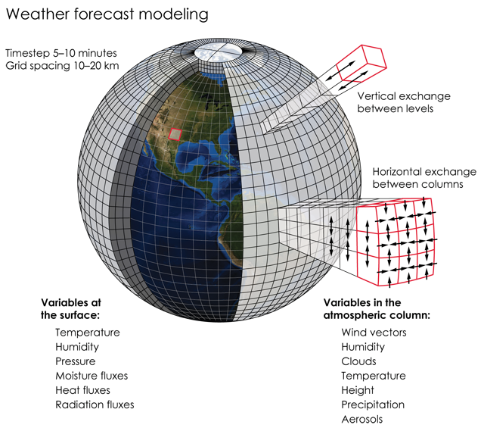
Numerical weather prediction models
What computer language those models are writen on?
How big are the computers they run on?
How much data they produce in one day?
Credits: K. Cantner, AGI.
Notes:
About 130 TB/day written (source https://www.ecmwf.int/sites/default/files/medialibrary/2019-01/02_DELLACQUA_INDUSTRYDAY_20190116.f.pdf)

Slide 8
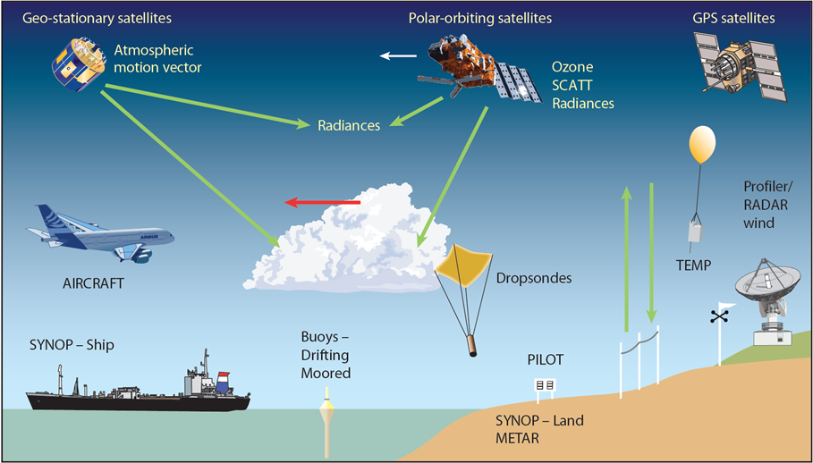
Data assimilation
Source: https://www.ecmwf.int/en/research/data-assimilation/observations
Notes:
ECMWF routinely processes data from around 90 satellite instruments as part of its operational daily data assimilation and monitoring activities. We receive 800 million observations daily, and 60 million quality-controlled observations are available daily for use in the Integrated Forecasting System (IFS); the vast majority of these are satellite measurements, but ECMWF also benefits from all available observations from non-satellite sources, including surface-based and aircraft reports.

Slide 9
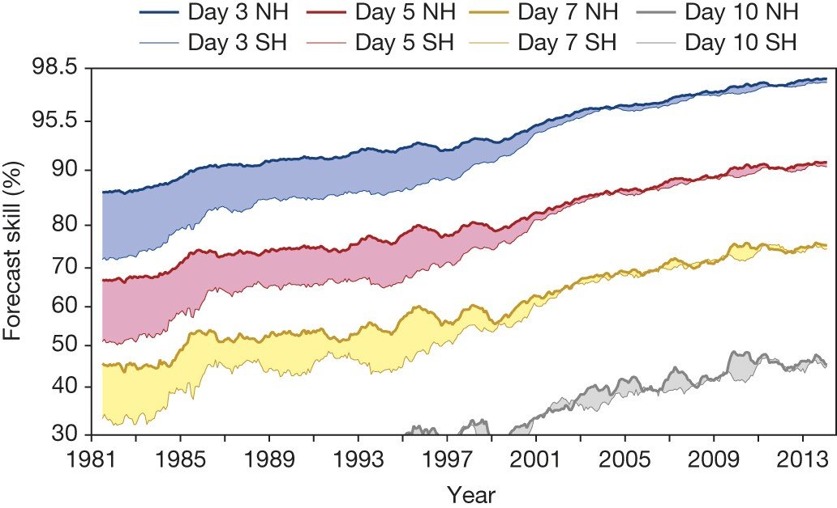
Improvements in NWP
Brauer et al., 2015 (The quiet revolution of numerical weather prediction)

Slide 10
Demo
Open plots from ECMWF
https://apps.ecmwf.int/webapps/opencharts
DWD open data server
https://www.dwd.de/EN/ourservices/opendata/opendata.html

Slide 11
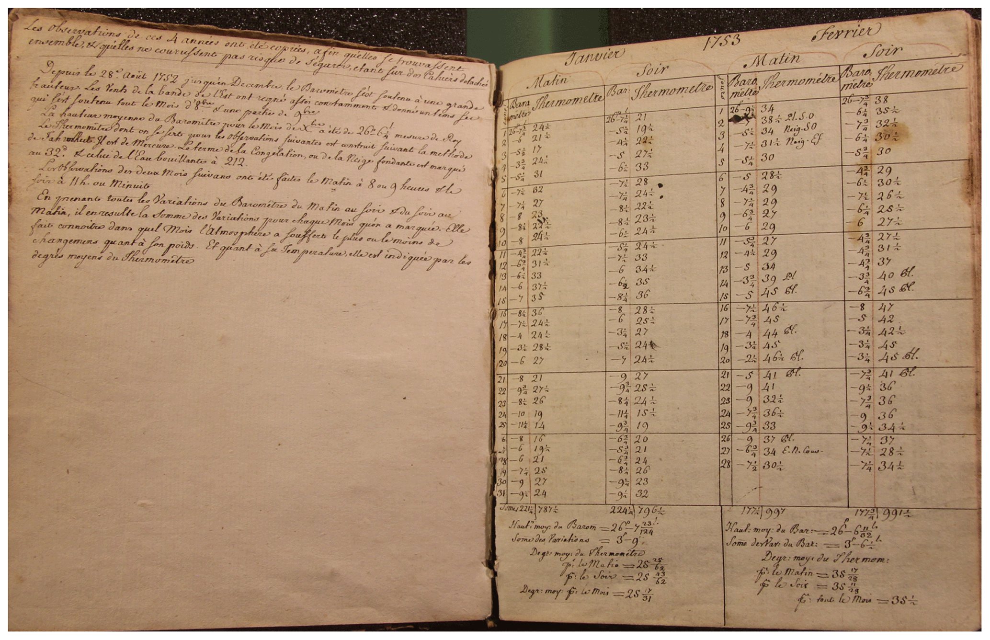
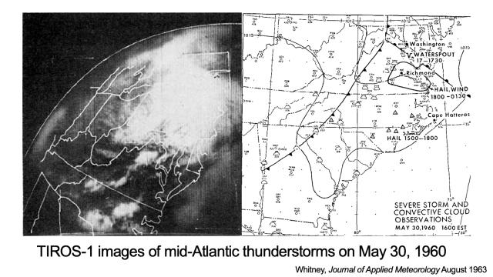
Reanalysis
Climate reanalyses combine past observations with models to generate consistent time series of multiple climate variables.
Sources: https://essd.copernicus.org/articles/12/1179/2020/ https://www.wral.com/first-weather-satellite-launched-this-day-in-1960/18297849/

Slide 12
Reanalysis
Good overview of what is available:
https://reanalyses.org/atmosphere/overview-current-atmospheric-reanalyses
Comparison table https://climatedataguide.ucar.edu/climate-data/atmospheric-reanalysis-overview-comparison-tables
Most famous ones (in my bouble ☺)
ERA5: https://cds.climate.copernicus.eu/cdsapp#!/home
JRA-55: https://jra.kishou.go.jp/JRA-55/index_en.html#quality
NCEP/NCAR Reanalysis I: https://psl.noaa.gov/data/gridded/data.ncep.reanalysis.html

Slide 13
Demo
Interactive work with NCEP and then with ERA5
Plot NCEP map for some date and region you interested in.

Slide 14
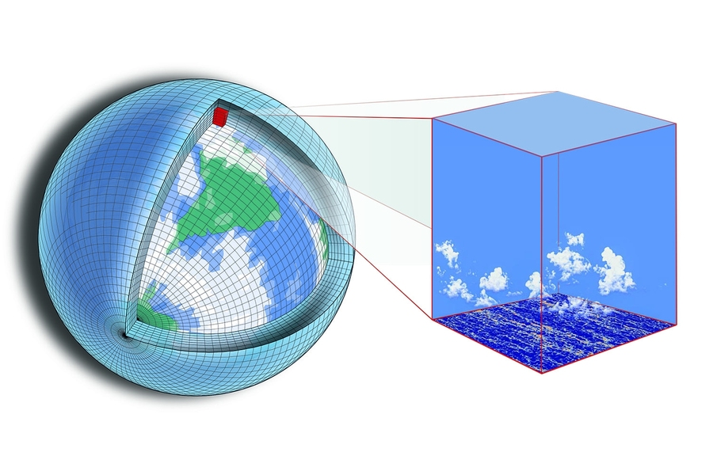
Climate simulations
Done with climate models, which can be different to NWP models.
They do not have data assimilation, use only limited forcing like GHC concentrations or solar irradiance.
Can be computed for past conditions (paleo simulations) or future (scenario simulations).
Source: https://news.mit.edu/2018/new-climate-modeling-alliance-clima-1212
Main components of climate modesl are Ocean, Atmosphere and Sea ice. The ESM models can include more componentd of the climate system, like vegitation, ice sheets, biogeochemistry and so on.

Slide 15
CMIP for IPCC
The most famous project of model intercomparison is CMIP (climate model intercomparison project) https://www.wcrp-climate.org/wgcm-cmip
Many modelling centres perform model simulations with their models according to the same protocol and made results available. The main source of CMIP data is ESGF: https://esgf-data.dkrz.de/projects/esgf-dkrz/
Results of the simulations provide input for IPCC reports and huge amount of scientific publications.

Slide 16
DEMO
Select model simulations from ESGF

Slide 17
Practice

Slide 18
NetCDF files
Download file(s) from NCEP/NCAR Reanalysis I: https://psl.noaa.gov/data/gridded/data.ncep.reanalysis.html

Slide 19
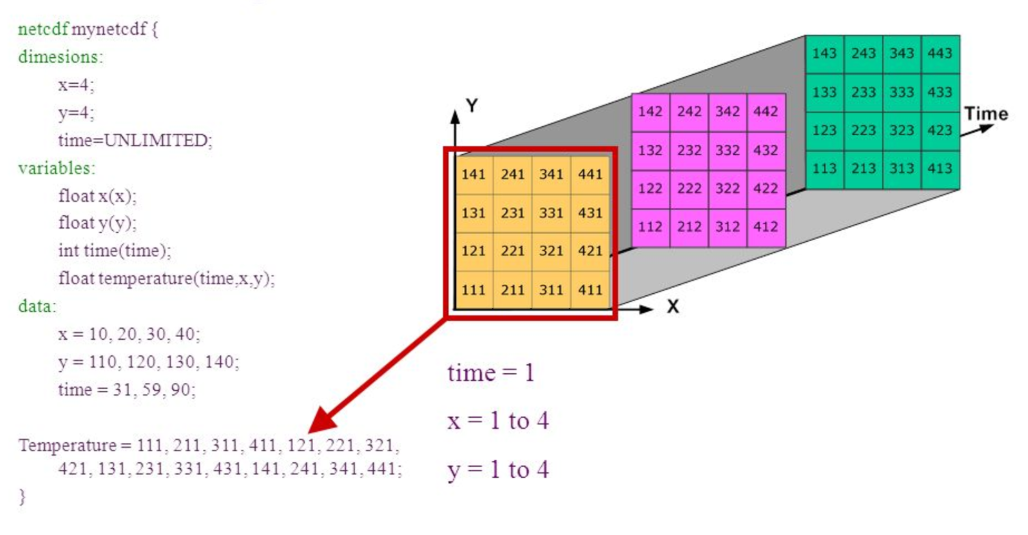
NetCDF files
De-facto standard for storing climate model data and many other geophysical fields.
Source: https://adyork.github.io/python-oceanography-lesson/17-Intro-NetCDF/index.html

Slide 20
NetCDF files
Visualization
The easiest way to look at the data is to use ncview http://cirrus.ucsd.edu/ncview/
Another popular program is panoply https://www.giss.nasa.gov/tools/panoply/download/
Comand line work
Simplest thing is ncdump, allows you to look at the header with:
ncdump –h file.nc
Processing of files can be done with:
Climate data operators (cdo) https://code.mpimet.mpg.de/projects/cdo/
netCDF Operator (NCO) http://nco.sourceforge.net/

Slide 21
NetCDF conventions
Community standards for encoding data in netCDF.
The most popular (and recommended by default) is CF (the conventions for Climate and Forecast): https://cfconventions.org/
The conventions for CF (Climate and Forecast) metadata are designed to promote the processing and sharing of files created with the NetCDF API. The conventions define metadata that provide a definitive description of what the data in each variable represents, and the spatial and temporal properties of the data. This enables users of data from different sources to decide which quantities are comparable, and facilitates building applications with powerful extraction, regridding, and display capabilities.
List of other conventions: https://www.unidata.ucar.edu/software/netcdf/conventions.html

Slide 22
Climate model data
Usually climate model data come in many flavours of netCDF (different variable names, conventions about seting coordinates and so on).
For CMIP projects two problems should be solved:
How to share large amounts of data: the answer is ESGF (Earth System Grid Federation) https://esgf-data.dkrz.de/projects/esgf-dkrz/
How to unify output of different models: the answer is CMOR table, that data should comply with. For CMIP6 one can find them here: https://github.com/PCMDI/cmip6-cmor-tables

Slide 23
Demo
Example of getting data from https://esgf-data.dkrz.de/projects/esgf-dkrz/

